Slide 1


Drops of LTSpice
How to use Operational Amplifiers

Slide 2
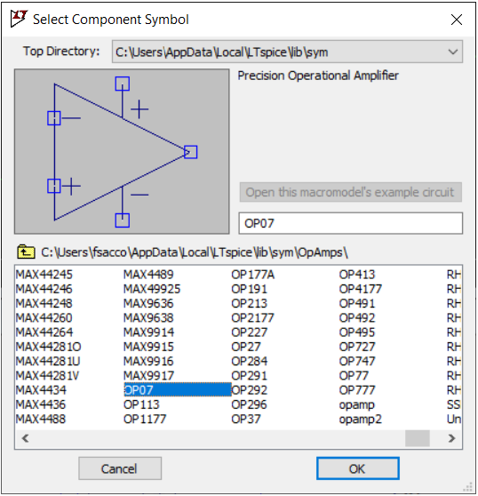
So... the operational amplifier is a basic component for electronic projects.
And of course LTSpice has a list of options in its library.

Slide 3
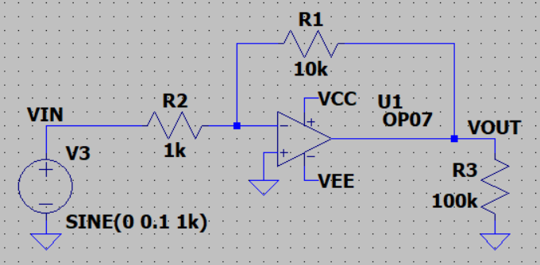
But there are some differences you need to consider.
Let's start with the basics.
A gain 10 inverting amplifier using an OP07.

Slide 4
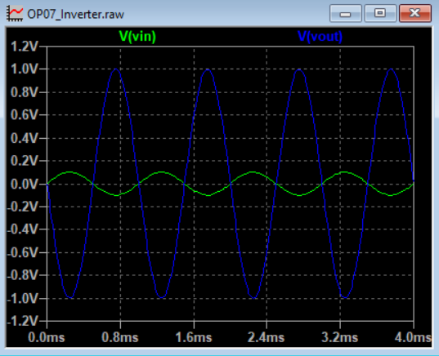
The result is correct as we expected.
A VIN signal of 100mV generates a VOUT signal ov 1V.

Slide 5
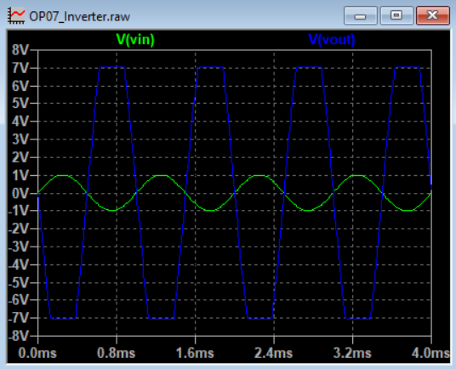
Considering an ±8V supply, a 1V VIN signal will saturate the output.
And that is exactly what we can see.
+8V
-8V

Slide 6
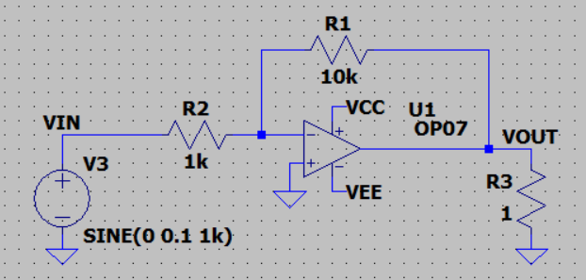
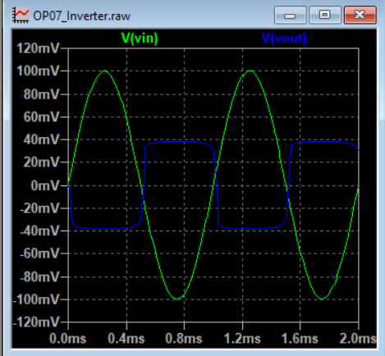
It also has a current limit on the output, like a real component.

Slide 7
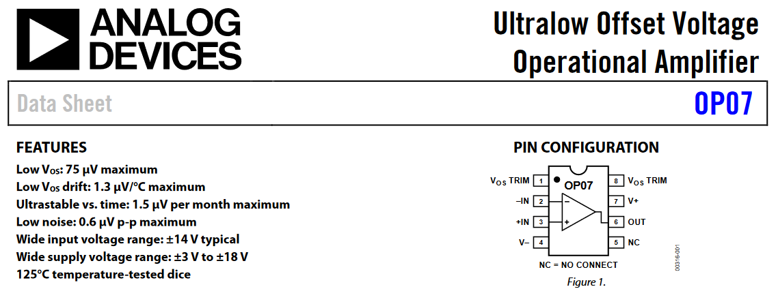
So, LTSpice simulates OP07 perfectly, right?
Well… yes and no.
Simulations don't work well outside of boundaries.
Let's imagine that we feed this same circuit with ±50V, even though the limit is ±18V.

Slide 8
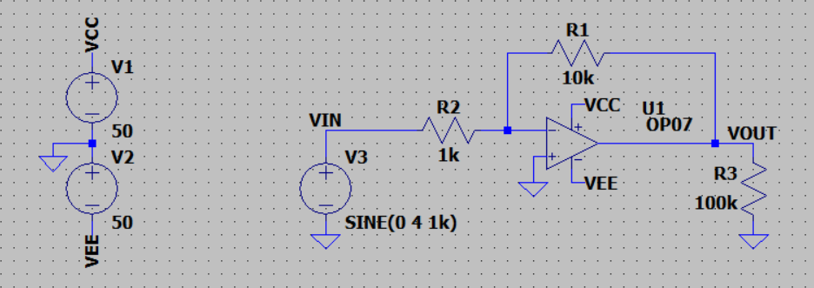
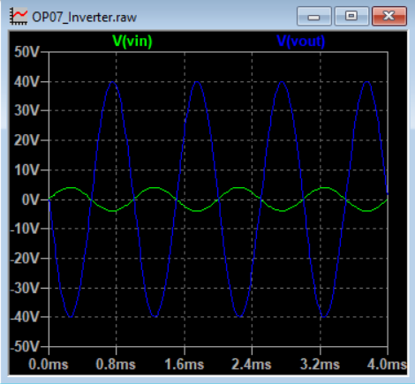
The simulation remains working, even if the circuit does not represent reality.

Slide 9
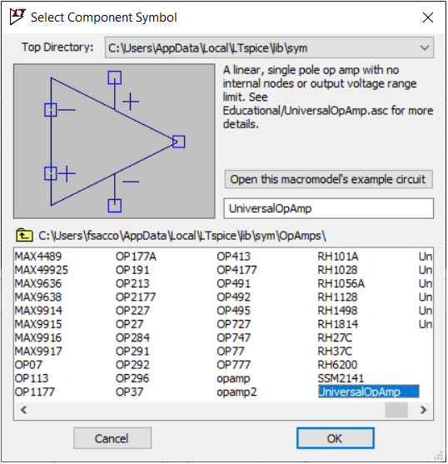
Now, let's get to know the universal amplifier.
LTSpice has the UniversalOpAmp, a component capable of behaving like an ideal amplifier.

Slide 10
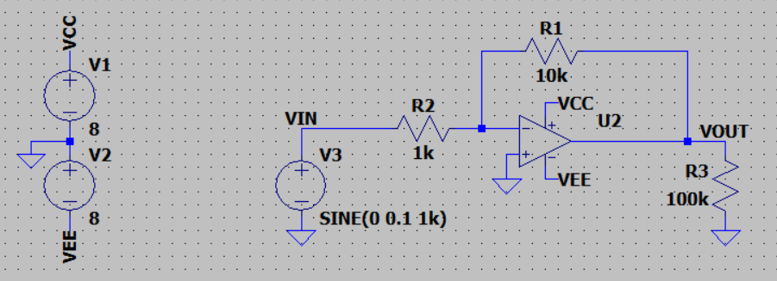
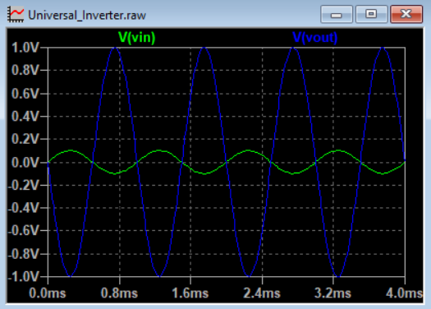
Repeating the tests, it behaves exactly as seen before.

Slide 11
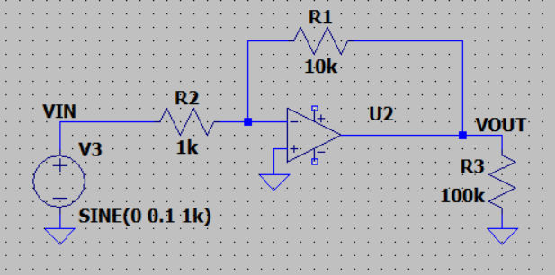
However, it does not require power to work.

Slide 12
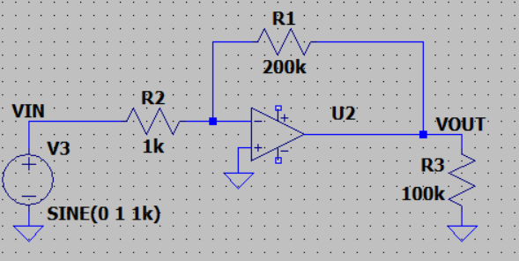
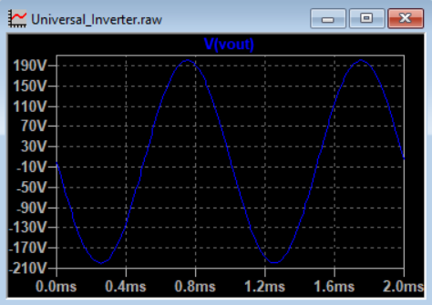
The gain seems to have no limits.

Slide 13
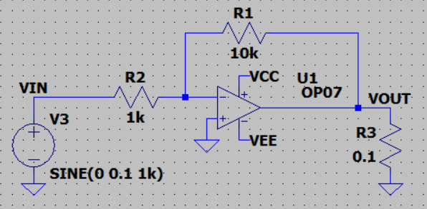
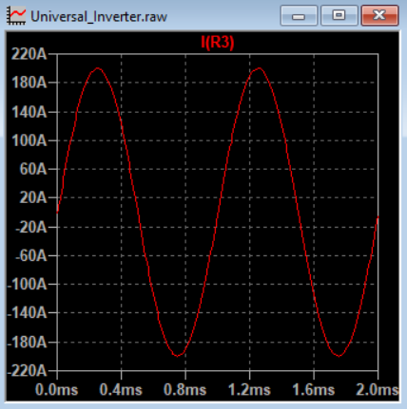
And… oh boy… you can draw current from it.
Francesco Sacco
linkedin.com/in/saccofrancesco

